Slide 1
CUDA Simulation and Rendering of Voxelized Cloud Volumes on the GPU
RICKY ARIETTA
CIS 565 FINAL PROJECT FALL 2013
UNIVERSITY OF PENNSYLVANIA

Slide 2

DESCRIPTION of project
WANT TO RENDER CLOUDS THAT MOVE AND RESPOND TO TRANSMITTANCE OF LIGHT IN BELIEVABLE WAY
USEFUL FOR AESTHETIC ANIMATIONS
DIVIDED INTO THREE MAIN PARTS:
INITIALIZATION OF CLOUD VOLUMES
SIMULATION OF CLOUD GROWTH/DECAY/MOTION
RENDERING

Slide 3
Part i: initialization of cloud volumes

Slide 4
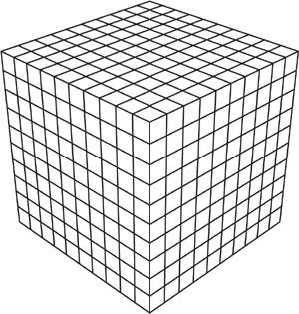
Part i: initialization of volumes
EACH VOLUME IS DEFINED BY A BOUNDING BOX INPUT FROM FILE ACCORDING TO A VOLUME STRUCTURE:
OUTLINE OF VOLUME DATA STRUCT:
bool isSet;
int volumeid;
int materialid;
float delt;
float step;
float velocity;
glm::vec3 xyzc;
glm::vec3 translation;
glm::vec3 rotation;
glm::vec3 scale;
cudaMat4 transform;
cudaMat4 inverseTransform;
voxel* voxels;

Slide 5
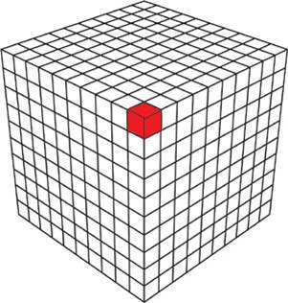
PART I: INITIALIZATION OF VOLUMES
EACH VOLUME STRUCT CONTAINS AN ARRAY OF VOXEL STRUCTS POINTING TO EACH INDIVIDUAL CLOUD PARTICLE
OUTLINE OF VOXEL DATA STRUCT:
char states;
float density;
float vaporProbability;
float extinctionProbability;
float phaseTransitionProbability;

Slide 6
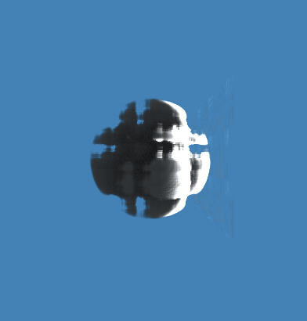

PART I: INITIALIZATION OF VOLUMES
DURING INITIALIZATION, A BLENDED PERLIN NOISE
FUNCTION IS GENERATED
UNBLENDED PERLIN NOISE RESTRICTED TO THE UNIT SPHERE AROUND THE ORIGIN
PERLIN NOISE FUNCTION:
TAKE AS ARGUMENTS A LOCATION VECTOR, A FREQUENCY, AN AMPLITUDE, AND A SEED
RETURNS A FLOAT WHICH IS THE SUM OF PERLIN NOISE OVER SEVERAL OCTAVES AT THIS POINT
PROCESS FOR GENERATION CLOUDLIKE PERLIN NOISE:
IN LOCAL SPACE, FIND COORDINATE OF VOXEL WITHIN VOLUME
FIND DISTANCE $\overline{D}$ FROM VOXEL TO LOCAL ORIGIN
IF $\overline{D}$ IS WITHIN BOUNDS DEFINED FOR CLOUD…
CONVERT VOXEL COORDINATE TO GLOBAL SCENE COORDINATES
PLUG INTO 2 SEPARATE PERLIN NOISE FUNCTIONS
BLEND RESULTS WITH MIX FUNCTION TO ACHIEVE FLOAT VALUE P
P = (P + (1.0 - (length / 0.5f)) * (0.5f - $\overline{D}$)

Slide 7
PART I: INITIALIZATION OF VOLUMES
EACH VOXEL’S ATTRIBUTES ARE INITIALIZED DEPENDING ON THEIR LOCATION IN THE BOUNDING VOLUME AND THE BLENDED PERLIN NOISE FUNCTIONS
ASSUME WE HAVE VOXEL[V] LOCATED AT POINT (X,Y,Z) IN THE VOLUME’S LOCAL SPACE
THEN…
float P = BlendedPerlinNoise(X,Y,Z)
density = P;
vaporProbability = P * 0.1f;
phaseProbability = P * 0.00003f;
extinctionProbability = (1.0f - P) * 0.9f;

Slide 8
PART I: INITIALIZATION OF VOLUMES
COPY EACH VOLUME’S PROPERTIES AND VOXEL ARRAY FROM THE DEVICE TO THE HOST SO THAT THEY CAN BE STORED FOR SIMULATION!

Slide 9
Part ii: cloud growth and simulation

Slide 10

PART II: GROWTH AND SIMULATION
SIMULATION FOLLOWS APPROACH OUTLINED MY FRANK KANE IN GAME ENGINE GEMS 2

Slide 11
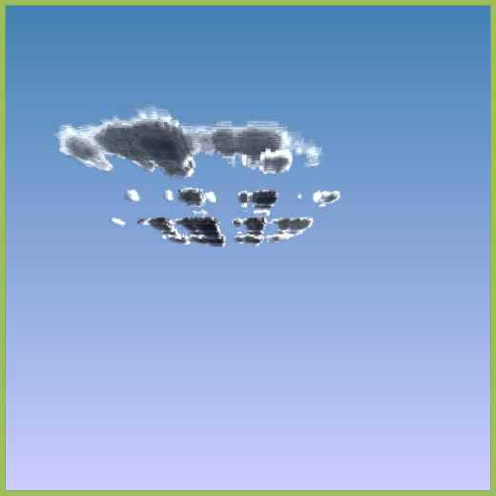
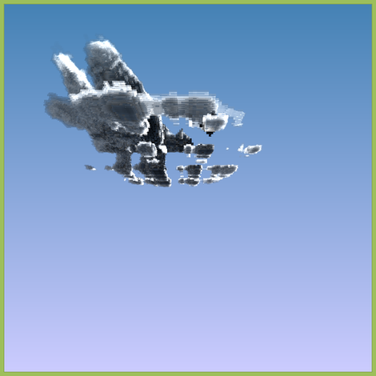
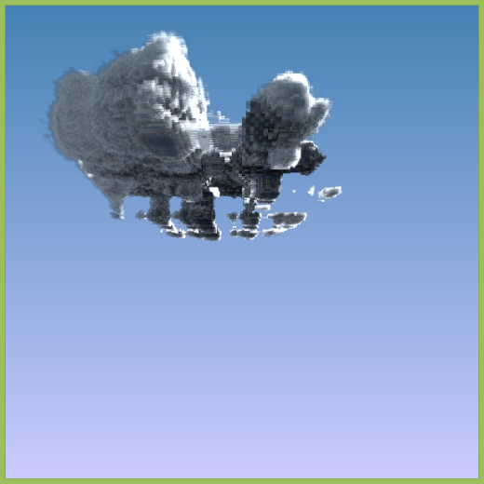
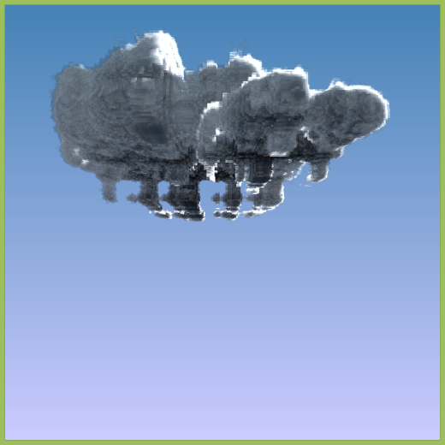
PART II: GROWTH AND SIMULATION
SIMULATE REALISTIC GROWTH OF CUMULUS CLOUD FORMS BY STARTING WITH BASE CLOUD LAYER AND BUILDING UP AND OUT

Slide 12
Part II: growth and simulation
EACH VOXEL HAS STATE BITS:
VAPOR
PHASE TRANSITION
CLOUD
AT EACH SIMULATION TIMESTEP, EXAMINE STATE BIT OF EACH HORIZONTAL NEIGHBOR AND NEIGHBOR BELOW
CHOOSE THREE RANDOM FLOATS AND COMPARE TO ASSIGNED PROBABILITY VALUES FOR EACH STATE FIELD; VOXEL WILL EITHER GAIN OR LOSE VAPOR/PHASE TRANSITION READINESS/CLOUD FORM

Slide 13
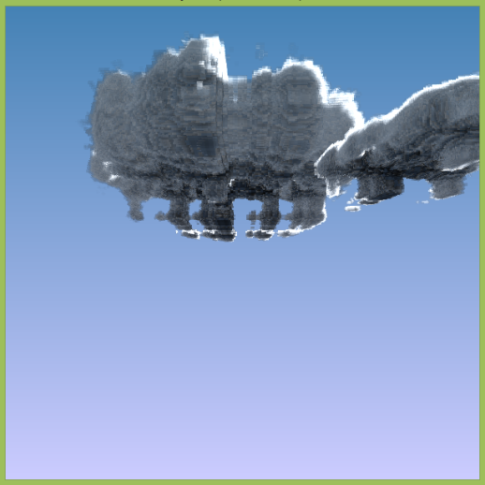
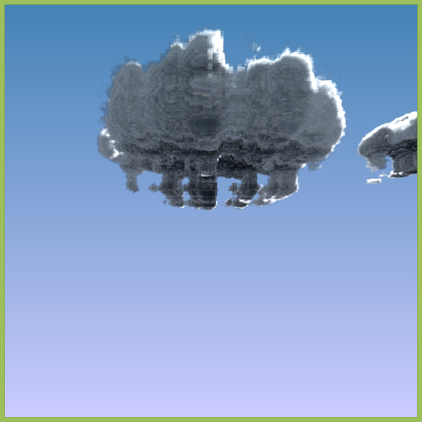
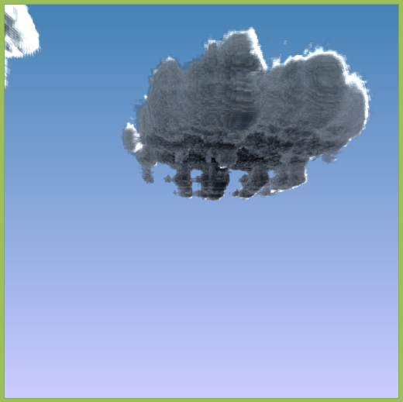
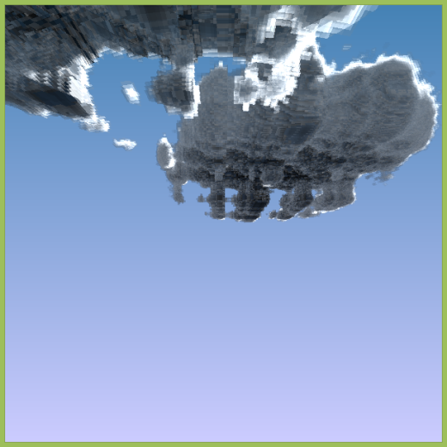
Part II: growth and simulation
CLOUD VOLUMES ALSO HAVE HORIZONTAL VELOCITY MAGNITUDES TO SIMULATE MOTION ACROSS THE SKY

Slide 14
Part iii: rendering

Slide 15
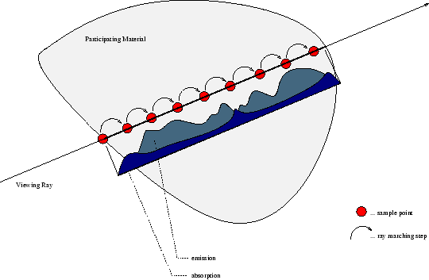
Part iii: rendering
RENDERING IS PERFORMED VIA RAY MARCHING ALGORITHM
CAST RAYS FROM CAMERA JUST LIKE IN PATH TRACER
CALCULATE INTERSECTION WITH BOUNDING BOX OF VOLUME
STEP THROUGH VOLUME BY STEP SIZE AND ACCUMULATE OPACITY UNTIL THRESHOLD IS REACHED
DO THIS FOR ALL VOLUMES

Slide 16
Part iii: rendering
ALONG EACH RAY CAST INTO THE VOLUME, OPACITY IS COLLECTED BASED ON PARTICLE DENSITY IN THE CURRENT CLOUD STATE
IF A VOXEL/PARTICLE HAS DENSITY BUT IS NOT SET IN THE CURRENT STATE AS A CLOUD BIT, THEN IT IS PASSED THROUGH
ALLOWING THE PROGRAM TO TERMINATE THE RAY MARCH AFTER A CERTAIN OPACITY IS REACHED ALLOWS FOR OPTIMIZATION OF RUNTIME

Slide 17
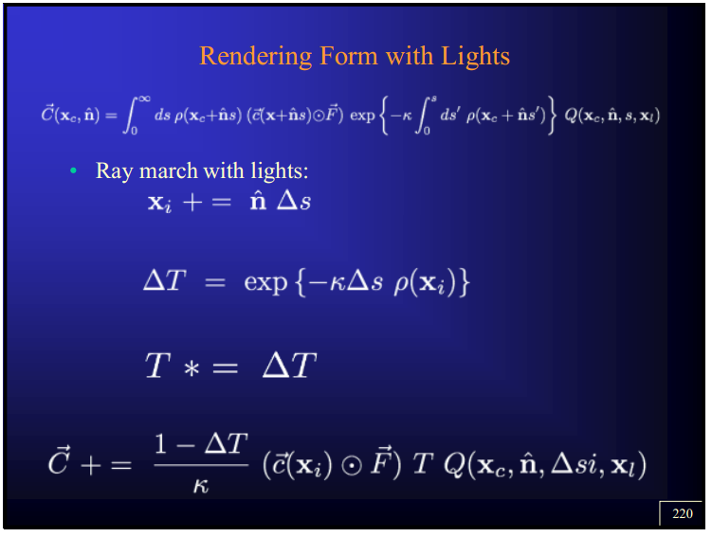
PART III: RENDERING
FOLLOWS THESE FORMULAS AT EACH STEP
(AS TAKEN FROM CIS 560 LECTURE NOTES):

Slide 18
Examples of final results

Slide 19
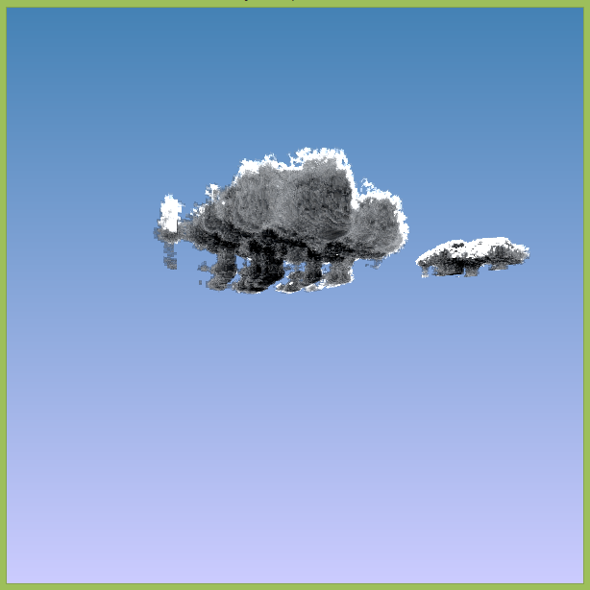
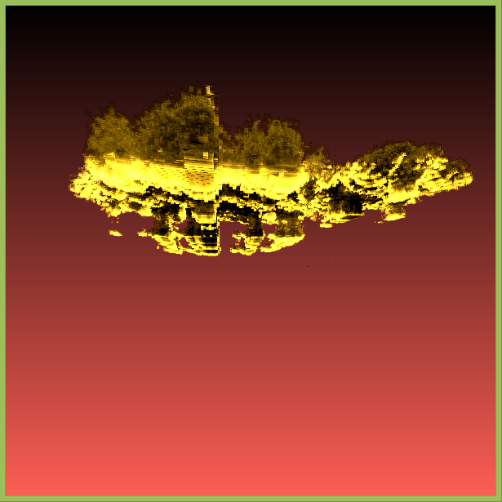
EXAMPLES OF CLOUD RENDERS
DAYTIME CLOUDS
SUNSET CLOUDS

Slide 20
EXAMPLES OF CLOUD RENDERS
LIVE DEMO…

Slide 21
Analysis and discussion

Slide 22
Performance numbers
FRAME RATE IS VARIABLE, DEPENDING ON DENSITY OF CLOUD VOLUMES IN CAMERA VIEW
WITH 2 SIMULATED CLOUD VOLUMES (AS IN DEMO), RUNS AT BETWEEN 14-16 FPS ON MY LAPTOP

Slide 23
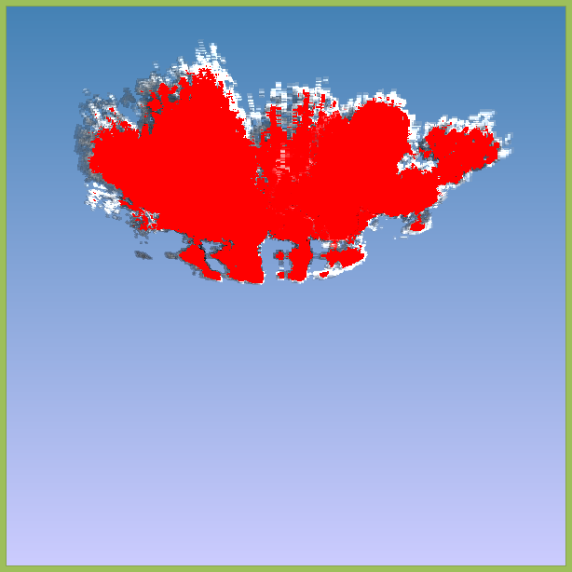
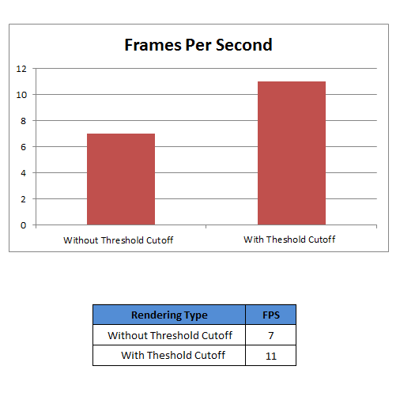
Performance numbers
THRESHOLD BOUNDING FOR RAY MARCHING

Slide 24
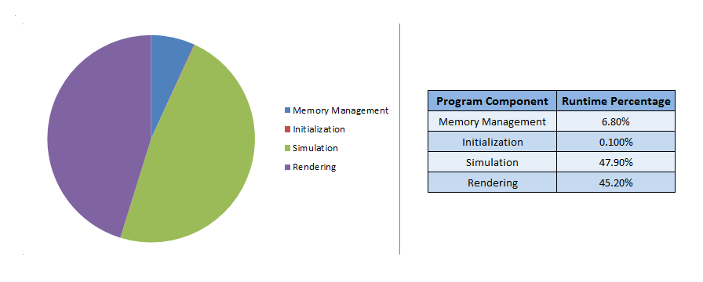
Performance numbers
RUNTIME BREAKDOWN

Slide 25
Future work
USER PLACED ART DIRECTABLE CLOUD VOLUMES
DIFFERENT TYPES OF CLOUDS – CURRENT PROJECT FOCUSES ONLY ON CUMULUS CLOUDS
WEIGHTED SAMPLING
TRY TO OPTIMIZE FOR RUNTIME SPEED

Slide 26
The end thank you!

